Slide 1
MIS637 Final Project
Predict term deposit subscription for bank direct marketing
Course: MIS637 (Spring-2017 )
Department: Information System
Prepared by: Xiao Chu
Student Id : 10386733
Guided by : Prof. Mahmoud Daneshmand

Slide 2
Introduction
There are two main approaches for banks to promote products and services: through mass campaigns or directed marketing, since positive responses to mass campaigns are very low, usually less than 1%, most banks now focus on directed marketing (by phone call in this project). Directed marketing, focus on targets that assumable will be keener to that specific product/service, making this kind of campaigns more attractive due to its efficiency. However, directed marketing has some drawbacks, for example, it may trigger a negative attitude towards banks due to the intrusion of privacy.
Nowadays, economical pressures and competition has led bank-marketing staffs to invest on directed campaigns with a strict and rigorous selection of contacts.
1

Slide 3
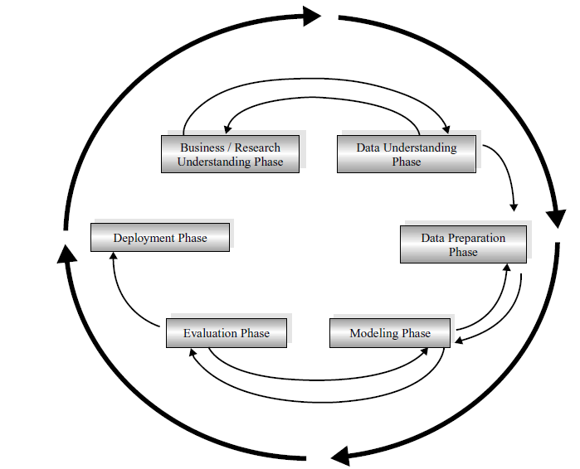
CROSS-INDUSTRY STANDARD PROCESS (CRISP–DM)
Business understanding phase.
Data understanding phase
Data preparation phase
Modeling phase
Evaluation phase
Deployment phase

Slide 4
Business Understanding
Profound Question:
Can we use the data of these clients who had been give a phone call building a model to explain success of a contact: whether a given client will subscribe a term deposit in future.
Goal:
The classification goal is to derive rules and predict whether a client will subscribe a term deposit by using C4.5 (variable y).
Accomplishments:
By using this model, we can increase campaign efficiency by identifying the main characteristics that affect success (client subscribe term deposit after call), and have a more rational estimate about which client is a high quality potential buying customers that we should contact first.

Slide 5
Data Understanding
Data Source:
The real-world data is related with direct marketing campaigns (term deposit promotion through phone calls) of a Portuguese banking institution.
Data set details:
Number of clients: 50,000
Number of Attributes: 17
Date Donated: 2012-02-14
Notes:
In this project, we apply a Data Mining (DM) approach to bank direct marketing campaigns. In particular, we used real-world and recent data from a Portuguese bank in order to tune the DM model results.

Slide 6
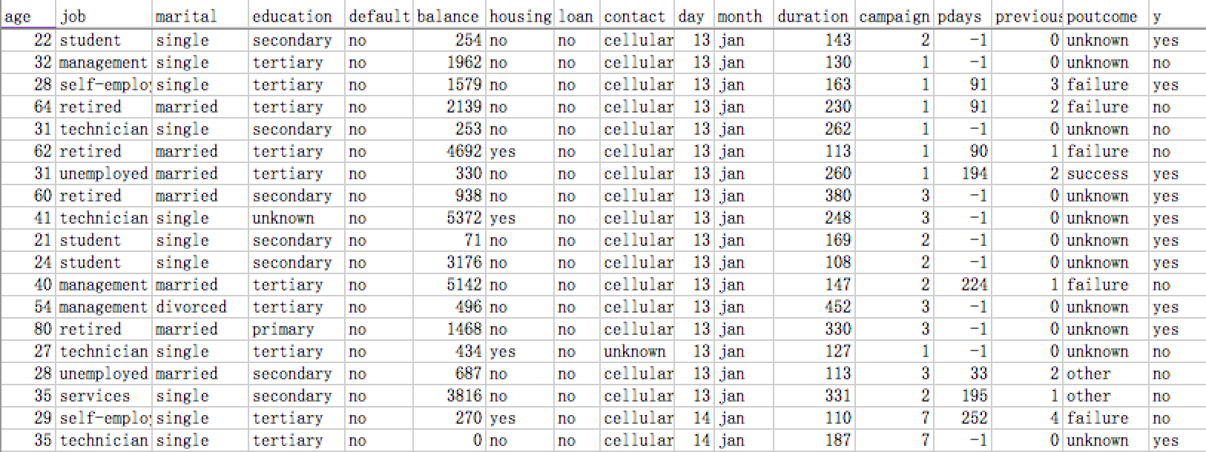
Data Understanding
Sample Data
Notes:
Number of clients: 50000
Number of Attributes: 17

Slide 7
Data Understanding
Attribute details:
1 Age: age of clients (continuous variable)
2 Job : type of job (discrete variable : “admin.”, “unknown”, “unemployed”, “management”, “housemaid”, “entrepreneur”, “student”, “blue-collar”, “self-employed”, “retired”, “technician”, "services")
3 Marital : marital status (discrete variable: “married”, “divorced”, "single”)
4 Education: education background (discrete variable: “unknown”, “secondary”, “primary”, "tertiary")
5 Default: has credit in default? (binary: “yes”, "no")
6 Balance: average yearly balance, in euros (continuous variable)
7 Housing: has housing loan? (binary: “yes”, "no")

Slide 8
Data Understanding
Attribute details:
8 Loan: has personal loan? (binary: “yes”, "no")
9 Contact: contact communication type (discrete variable: “unknown”, “telephone”, "cellular")
10 Day: last contact day of the month (continuous variable)
11 Month: last contact month of year (categorical: "jan", "feb”, ..., "nov", "dec")
12 Duration: last contact duration, in seconds (continuous variable)
13 Campaign: number of contacts performed during this campaign and for this client (continuous variable, includes last contact)

Slide 9
Data Understanding
Attribute details:
14 Pdays: number of days that passed by after the client was last contacted from a previous campaign (continuous variable:-1 means client was not previously contacted)
15 Previous: number of contacts performed before this campaign and for this client (continuous variable)
16 Poutcome: outcome of the previous marketing campaign(discrete variable: “unknown”, “other”, “failure”, "success")
Output variable (desired target):
17 y - has the client subscribed a term deposit? (binary: "yes","no")

Slide 10
Data preparation
Data Clean
Handle Missing values & Identify outliers:
Few clients with missing values for the attribute Job and Housing have been delete.
No outliers have been found in origin data.
Look for attributes that might need transformation.
No attributes that need transformation.
Attribute selection: select attributes appropriate for analysis.
No irrelevant attributes.

Slide 11
Data preparation
Data division:
After data clean, the data set consisting of 49,733 records is divided into 2 sets.
Training data set: 90%of the data (45,212 records) is used to develop the model.
Testing data: 10% of the data (4,521 records) is used to evaluate the model.

Slide 12

Modeling
Which algorithm?
The target variable is categorical (yes, no) and is not continuous, Classification is the right choice.
Classification : predicts categorical class labels and classifies data based on the training set and the values in a classifying attribute and uses it in classifying new data.
C4.5 algorithm: an extension of ID3 algorithm. C4.5 recursively visits each decision node, selecting the optimal splits, until no further splits are possible. It makes use of the concept of information gain or entropy reduction to select the optimal split.

Slide 13


Modeling
Which software?
SPSS Clementine 12.0 is a data mining and text analytics software application built by IBM.
It is an extensive predictive analytics platform that is designed to built predictive models, conduct analytic tasks and bring predictive intelligence to decisions by providing a range of advanced algorithms and techniques.

Slide 14
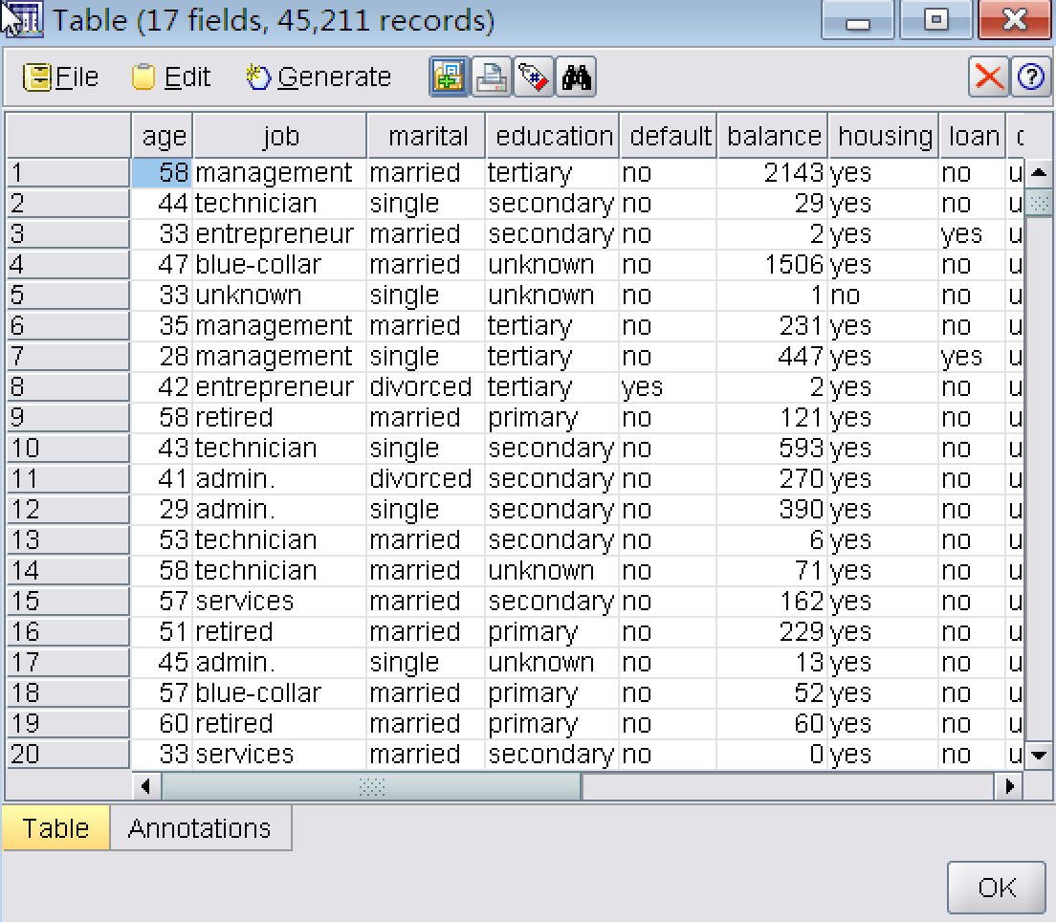
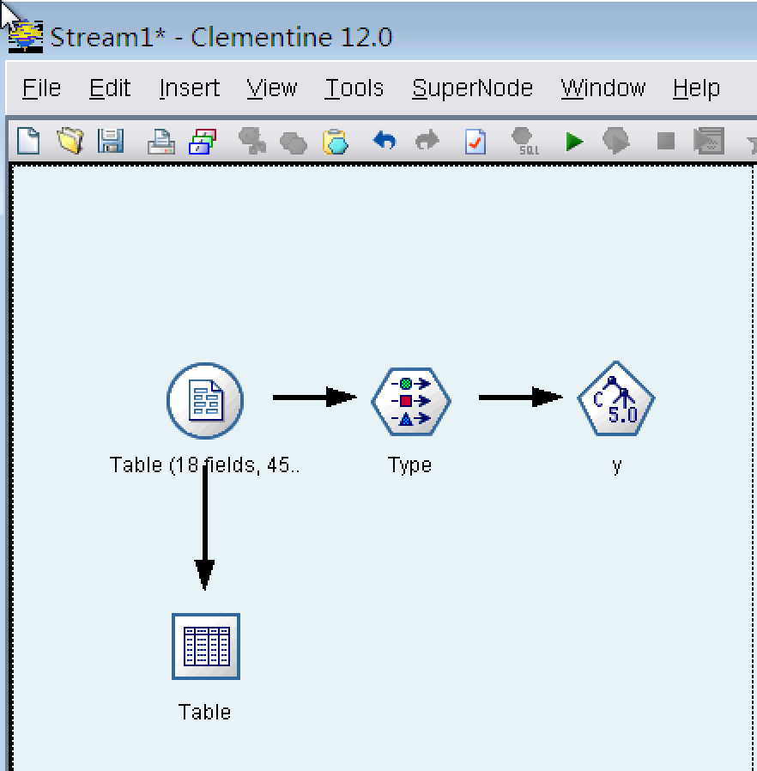
Modeling
Training Data
Notes:
The original dataset is in .csv format, we input it in clementine and it will be transformed to a table showed here.

Slide 15
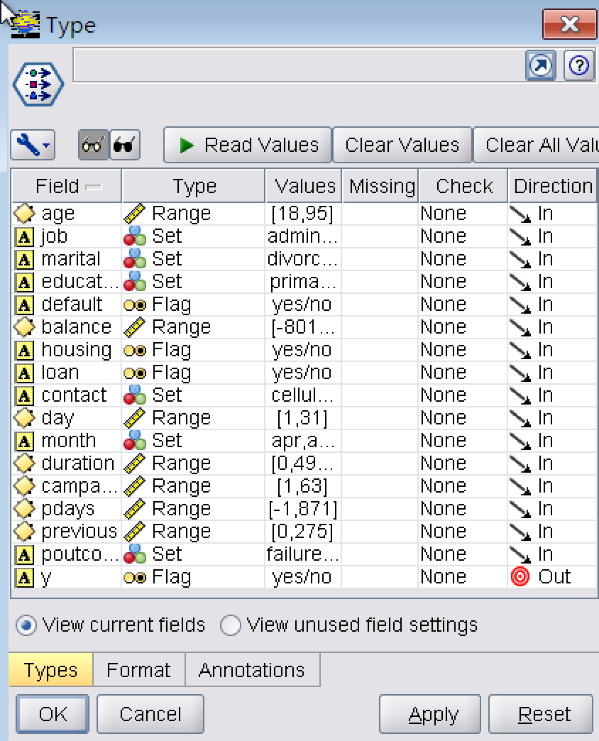
Modeling
Input & Output Variables
Notes:
use “type” to set input variables and output variables, all the first 16 attributes are predictor variables, so we just need to set Y as output

Slide 16
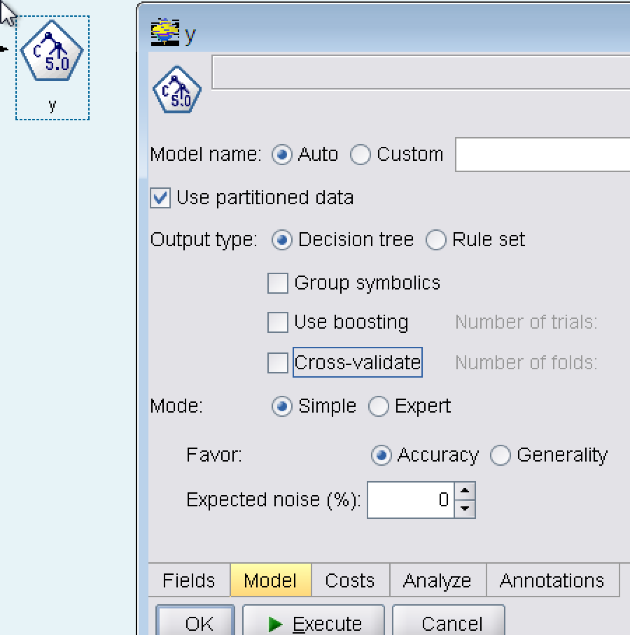
Modeling
Set the model and execute it, then the model is trained with the C4.5

Slide 17
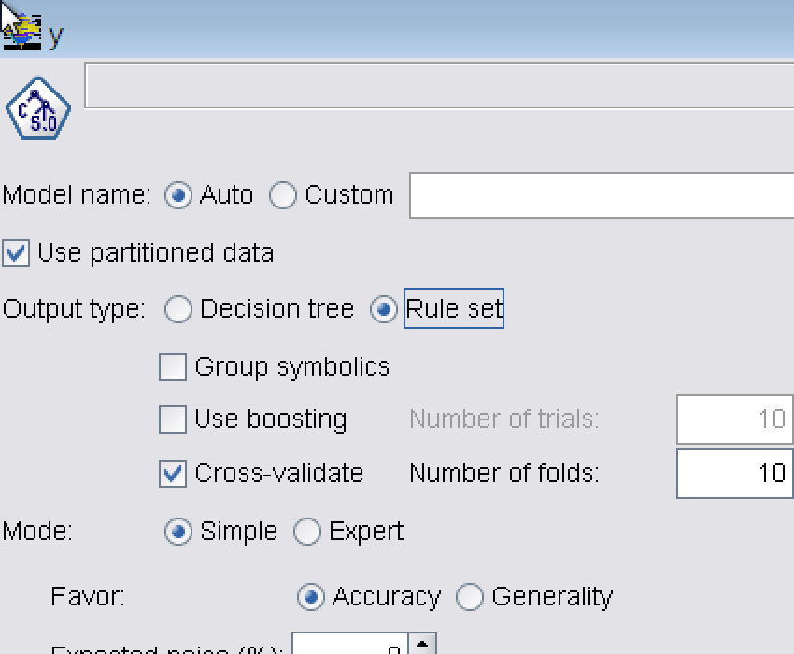
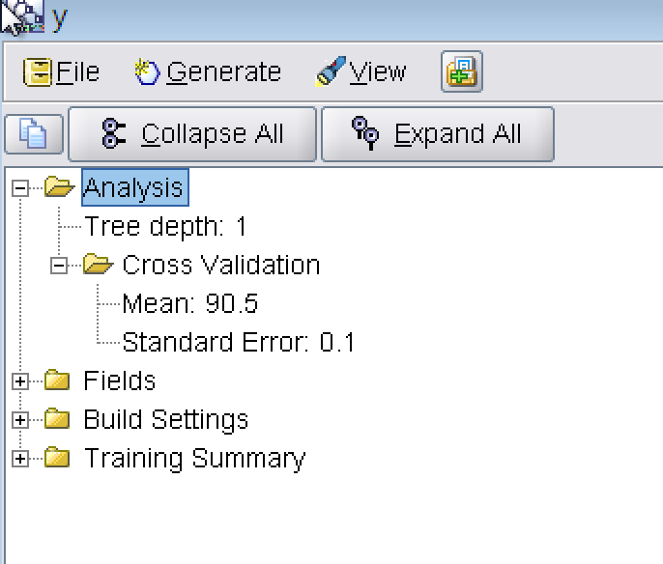
Modeling
Choose Cross-validation and choose folds as 10.
When the full data was used, 90.5% of the clients were correctly classified.
Notes:
After training the model, we reset it by using cross-validation.

Slide 18
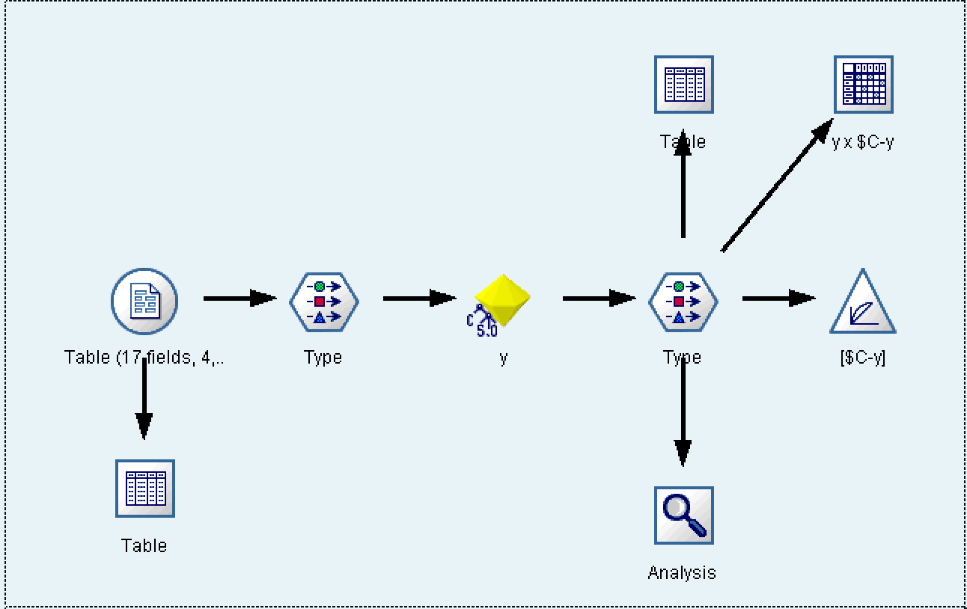
Modeling
Use the test dataset to test the training model
Lift
Notes:
To test the training model, we use test dataset.

Slide 19
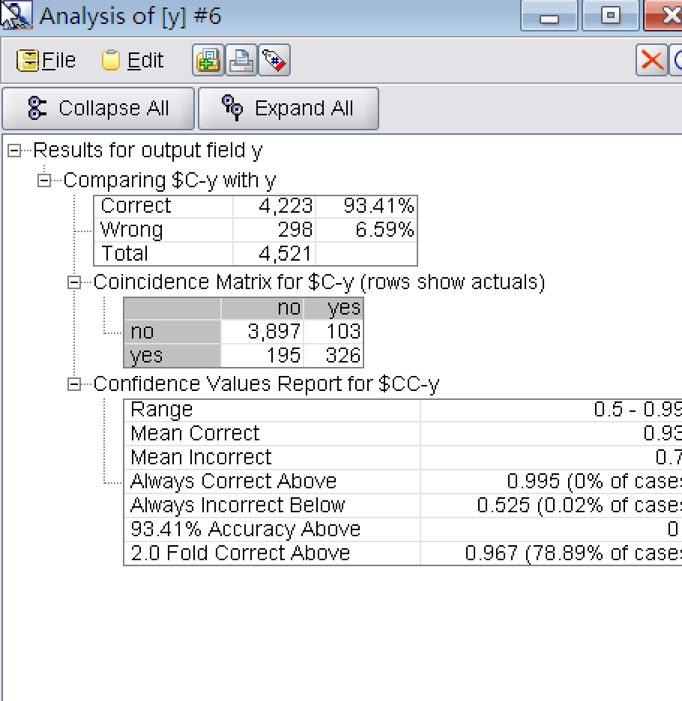
Modeling
Accuracy: 93.41%
NO: 3897, 103
Yes: 195, 326
Notes:
The running result here shows the performance of model on the test dataset,
It shows an improvement in performance, the accuracy increases from 90.5%for the training data to 93.41% for testing data.
Although the model’s accuracy is high, it may not that reliable for the real performance of a classifier.
Coincidence matrix

Slide 20
Evaluation
Coincidence Matrix
NO: 3,897 true “no”, 103 false “yes”
Yes: 195 false “no”, 326 true “yes”
Shows a high accuracy in predicting “no” while a low accuracy when predicting “Yes”.
This is because the model often yield misleading results if the data set is unbalanced, as in this project, we have 4000 “no” and 521”yes”, the classifier could easily be biased into classifying all the samples as “no”.
However, we still can use this mode to predict a “yes” due to the lifting and gain chart.
Notes:
the model often yield misleading results if the data set is unbalanced (that is, when the number of samples in different classes vary greatly) AS in this project, we have 4000 “no” and 521”yes”, the classifier could easily be biased into classifying all the samples as “no”. The overall accuracy would be 93.41%, but in practice, the classifier would have a 97.5% recognition rate for the “no” class but a 63% recognition rate for the “yes” class.
The coincidence matrix reports the number of false positives, false negatives, true positives, and true negatives

Slide 21
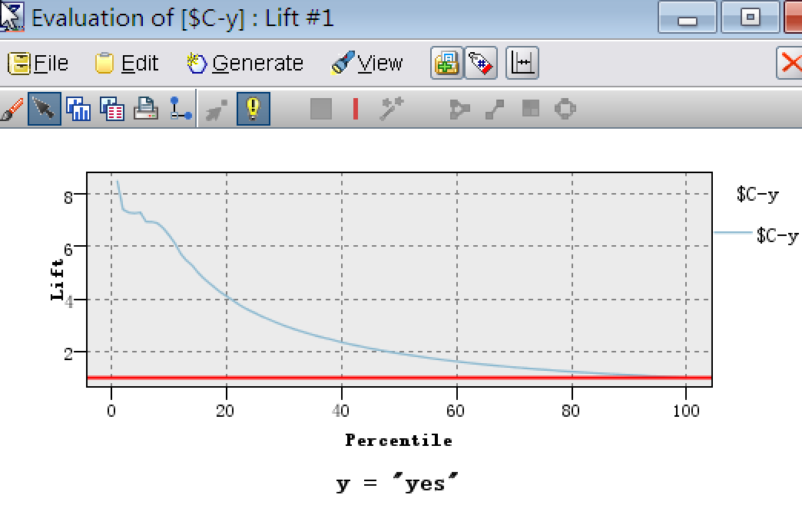
Evaluation
Lifting is a measure of the effectiveness of a predictive model calculated as the ratio between the results obtained with and without the predictive model.
For contacting 10% of customers, using no model we should get 10% of positive responders and using the given model we should get 60% of positive responders.
6 Times accurate
4 Times accurate
Notes:
This chart Shows the actual lift. Red one is baseline, Blue line is lift curve by using this model

Slide 22
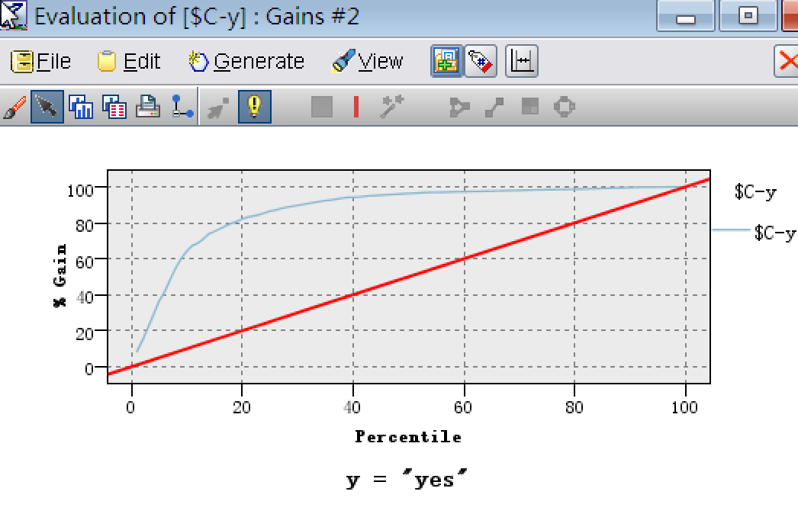
Evaluation
Gains Chart
The y-axis shows the percentage the total possible positive responses(“yes”)
The x-axis shows the percentage of customers contacted
By using this model, we just need to contact 50% of clients to receive 90% of the “yes” response.
Notes:
The Gains curve is simple to read
RED--Baseline WITHOUT the model: If we contact X% of customers then we will receive X% of the total positive responses.
Blue line tells if we look at top 50% of the data we would capture almost all the “yes”responses

Slide 23
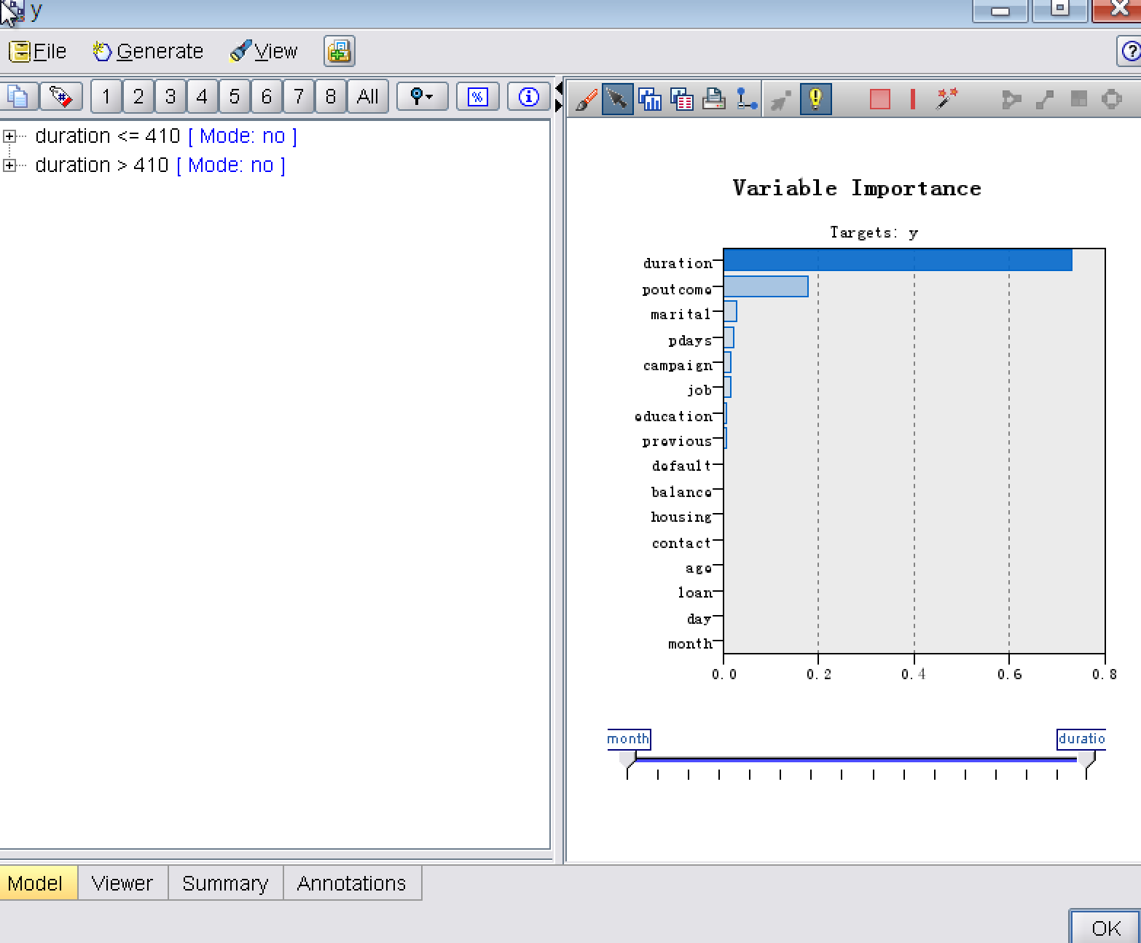
Evaluation
Variable Importance
Call duration is the most relevant feature, meaning that longer calls tend increase successes.
Notes:
Not fit for new clients

Slide 24
Evaluation
Variable Importance
5 of the first 8 important variables are relevant with our last contact means this model may not apply to new customers.
In future work, we need to collect more client based data, in order to check if high quality predictive models can be achieved without contact-based information.

Slide 25
Deployment
Since the model achieved high predictive performances,it can be used to enhance campaigns
-We could execute the model on the group of clients we have made phone calls before.
-When the bank doesn’t have enough time or founds to contact all potential customers, we can use this model to decide the contact order thus to increase the success rate and save campaign cost.
-Train the bank agents with contact skills to increase the length of their phone calls.

Slide 26
References
Data source:
http://archive.ics.uci.edu/ml/datasets/Bank+Marketing
Software:
http://www-01.ibm.com/software/analytics/spss/
http://pic.dhe.ibm.com/infocenter/spssmodl/v15r0m0/index.jsp?topic=%2Fcom.ibm.spss.modeler.help%2Fclem_intro.htm
Other References:
S. Moro, R. Laureano and P. Cortez. Using Data Mining for Bank Direct Marketing: An Application of the CRISP-DM Methodology. In P. Novais et al. (Eds.), Proceedings of the European Simulation and Modelling Conference - ESM'2011, pp. 117-121, Guimaraes, Portugal, October, 2011. EUROSIS.
Aptéa, C. and Weiss, S. 1997. “Data mining with decision trees and decision rules”, Future Generation Computer Systems 13, No.2-3, 197–210.

Slide 27
Thank you !

